Slide 1


CAPSTONE PROJECT
PROJECT TITLE
Presented By
Student Name: CHALAMALA SETTI VINEETHA
College Name : Vignan’s Institute of engineering for women’s
Department : Computer Science and engineering
Email ID: chvineetha2005@gmail.com

Slide 2
OUTLINE:
Problem Statement (Should not include solution)
Proposed System/Solution
System Development Approach (Technology Used)
Algorithm & Deployment
Result (Output Image)
Conclusion
Future Scope
References

Slide 3
Problem Statement:
E-commerce businesses generate large volumes of transactional data related to sales, customers, products, and shipping activities. However, analyzing this data to understand customer purchasing behavior, regional sales performance, and product profitability is often difficult. Businesses also face challenges in identifying how factors such as discounts and shipping costs influence profit and overall performance. Without clear analysis, it becomes difficult for organizations to identify trends, evaluate product demand, and make informed business decisions.

Slide 4
Proposed Solution:
Develop an interactive data analysis system to study e-commerce business data.
Transform raw transactional data into meaningful business insights.
Analyze important metrics such as sales, profit, customer segments, and regional performance.
Evaluate product categories, discounts, and shipping costs to understand business performance.
Organize and present data through structured analysis and visualization.
Help stakeholders identify trends, profitable products, and customer behavior patterns.
Support data-driven decision making for business improvement.

Slide 5
System Approach:
The system is developed using data visualization and business intelligence techniques to analyze e-commerce customer behavior and sales performance. The process involves collecting the dataset, preparing and cleaning the data, and creating interactive visualizations to extract meaningful insights. Various chart types are used to analyze different aspects such as sales trends, customer segments, product performance, and regional distribution. Interactive filters and slicers are implemented to allow users to dynamically explore the data and gain deeper insights.
Technologies Used
Microsoft Power BI – For data visualization and dashboard development
E-commerce Dataset – For analyzing sales, profit, and customer behavior
Data Modeling – To organize and relate different data fields
Interactive Visualizations – Bar charts, line charts, donut charts, scatter plots, and maps
Slicers and Filters – To enable dynamic data exploration

Slide 6
Algorithm & Deployment:
Algorithm Selection
BI & Data Visualization
Aggregation and filtering
Data Input
E-commerce transaction data
Sales, Profit, Discount, Shipping
Data Processing
Data cleaning
Data transformation
Analysis
Sales & profit trends
Customer behavior insights

Slide 7
Result:
Developed an interactive Power BI dashboard for e-commerce analysis.
Visualized sales, profit, shipping cost, and order trends.
Analyzed customer segments and regional sales distribution.
Identified top-performing products and profitable categories.
Evaluated impact of discounts on profit and shipping cost trends.

Slide 8
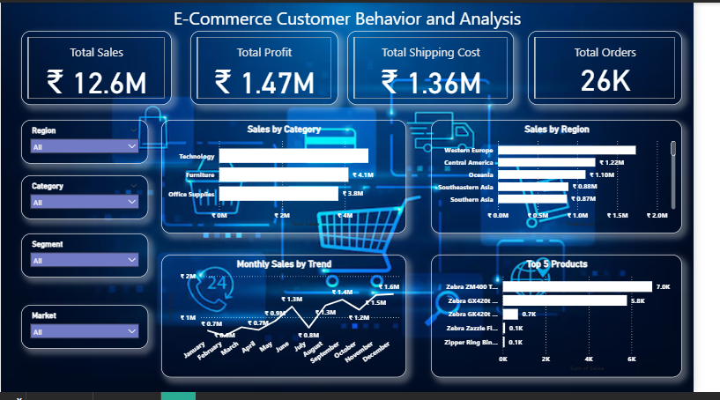
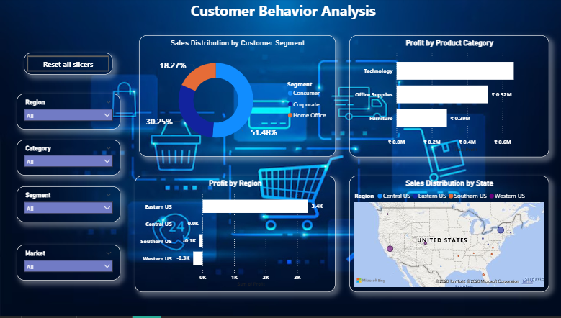

Slide 9
Conclusion:
Learned data visualization and dashboard creation using Microsoft Power BI.
Applied data cleaning, modeling, and visualization techniques.
Built an interactive dashboard to analyze global income inequality.
Internship enhanced practical skills in data analysis and business intelligence.

Slide 10
Future scope:
Integrate real-time economic datasets for updated insights.
Expand the dashboard to include more countries and indicators.
Apply advanced analytics and predictive models.
Deploy dashboards for organizational decision making.

Slide 11
References:
Official documentation and learning resources from Microsoft Power BI.
E-commerce dataset used for sales and customer behaviour analysis.
Data visualization and dashboard design concepts from Microsoft Learn.
Additional analytics resources from Kaggle datasets and community discussions.
GitHub Link: https://github.com/vineetha-20/E-Commerce-Customer-Behavior-and-Analysis-Dashboard

Slide 12
Thank You

